Slide 1

Data Analytics for Cybersecurity Tweet for Tat: Robust Sentiment Analysis with Cybersecurity Application
Submitted by:
Chahak Mittal
Ethan Smith

Slide 2

Objective
Using sentiment analysis and data mining techniques on some original tweets to predict whether the sentiments behind those could be the reason a company might face a cyber-attack.

Slide 3

Process
Twitter analysis is beneficial in a way that it is a real-time analysis, scalable and a rational and evident norm.
The process of twitter analysis involves accumulation of data from trustworthy sources, arrangement of the data (cleaning, prioritizing and systematic construction), generation of a sentiment analysis model and last but not the least anticipating and apprehending the results.

Slide 4
Prior Work
We reviewed papers* related to sentiment analysis and its application in the field of cybersecurity and learned following:
To operate our experiment on real-time and real-world data, understanding the various emotions and conducts projected to cyber attacks
To establish the performance and validation of sentiment analysis model.
To analyse the tweets, main keywords, types of feedbacks, determine the underlying sentiment behind a comment and help explain the visualizations in a simple and an effective way.
* Please look at Slide 6 for citations

Slide 5
Problem Statement
Collect and perform sentiment analysis on the datasets collected for Apple Inc. and an airline company.
Sort and review tweets about these organizations to understand their susceptibility to cyber attacks.
Feedback analysis by the consumers which answers the ‘to be or not to be’ dilemma of an organization to get attacked and help the company come up with a solution to consumer issues as well as to observe the eccentricity and distinctiveness of their product and services.
The final product from our project will help companies to understand the way people think and react to their products, services and brand and analyse the weaknesses which could prove to be disastrous for them.

Slide 6

Methodology

Slide 7
Topic
Our model is trained and tested on two datasets of tweets that are a maximum of 240 characters in length.
The first dataset is a labelled collection of tweets directed toward the Apple Corporation and the second is a labelled collection of tweets directed toward a variety of US airlines.
Two different models, naïve bayes and a logarithmic regression, are trained and tested on each dataset with the objective of labelling the tweets according to a binary sentiment label.
Each dataset will serve as testing/training data and validation data for each model.
Finally, the overall performance the models are compared using confusion matrices, accuracy, precision, and recall.

Slide 8
Topic
Even short documents like tweets are ripe for analysis and can contain valuable insight into whether an organization is likely to be targeted by a cyberattack
Public opinion has proven to be a reliable barometer for what kind of companies and governments eventually draw the ire of hackers and activists.
Twitter is accessible, instant, and easy to use, making it a better litmus test for public sentiment than news articles or blogs
Granular sentiment analysis capable of identifying key topics, themes, and implications is valuable, but the cybersecurity application is interested in vitriol
The models evaluated in this experiment focus on identifying the overall proportion of ‘negative’ sentiment rather than identify certain topics or themes.

Slide 9
Data
Two core datasets are used in this project.
The first is a dataset produced by the crowdsourcing website Crowdflower that was hosted on the dataset repository website data.world under the name Apple Twitter Sentiment. This dataset is henceforth referred to as “Apple” or “the Apple dataset.”
The other dataset used is a similar Crowdflower dataset outside on dataset repository website Kaggle named Twitter US Airline Sentiment, henceforth referred to as “Airline” or “the Airline dataset.”

Slide 10
Data - Apple
Tweets from 2014 that discuss the Apple Corporation (either use #AAPL or @apple).
Key Attributes:
Human created sentiment code: 1 – negative, 3 –neutral, 5-positive (or “not relevant”)
Number of trusted evaluations
Average “sentiment_confidence” score
Size:
3,886 Tweets

Slide 11
Data - Airline
Tweets from 2015 that that tag a variety of major airlines (@VirginAirlines, @Delta, @Southwest, etc.)
Key Attributes:
Human created labels of “negative,” “neutral,” and “positive” (or “not relevant”)
Airline
“Sentiment_confidence” score
Various information about the twitter user and post (location, time, etc)
Size:
14,641 Tweets

Slide 12
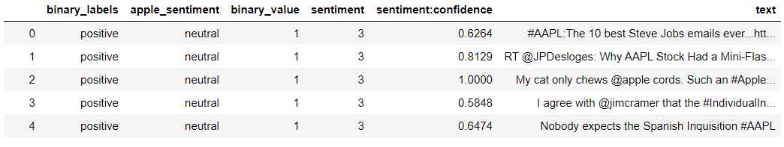
EDA - Apple
Note: neutral tweets are labeled “positive.” Our analysis works on binarized data.
Neutral tweets are counted as positive because we are only interested in the most negative of negative tweets, and a brand wants people talking about them.

Slide 13
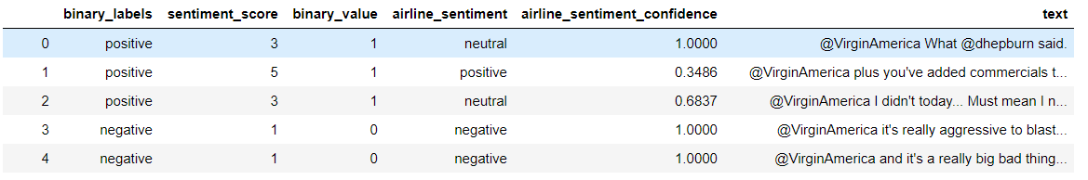
EDA - Airline
The integer codes in the Apple dataset were converted to string labels, and vice versa for the Airline dataset so that both datasets have a column with both.

Slide 14
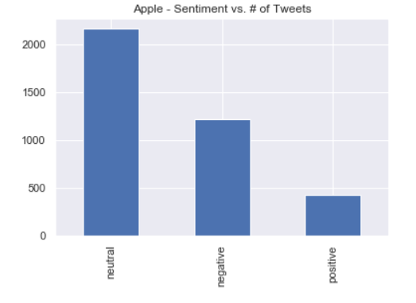
EDA - Apple
Exact Counts:
Neutral: 2,162
Negative: 1,219
Positive: 423

Slide 15
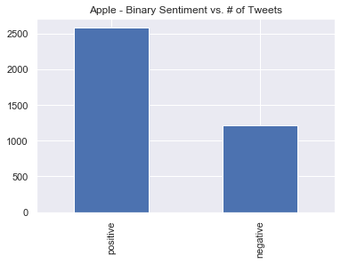
EDA - Apple
Exact Counts:
Positive: 2,285
Negative: 1,219

Slide 16
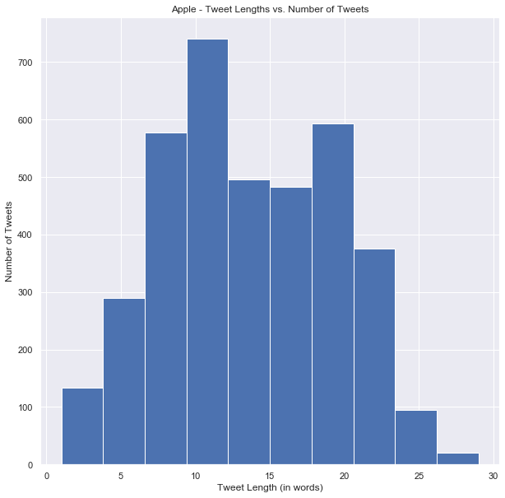

Slide 17
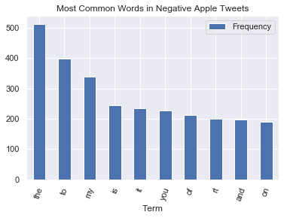
EDA - Apple
Term | Frequency
the | 513
to | 398
my | 338
is | 245
it | 234
you | 227
of | 200
and | 198
on | 190

Slide 18
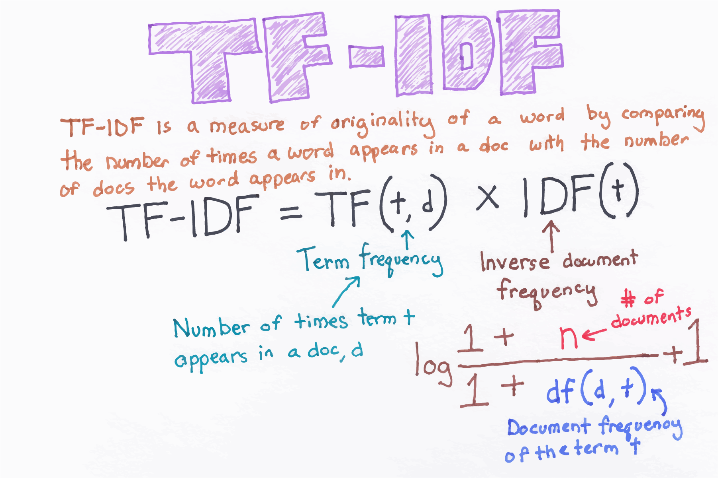

Slide 19
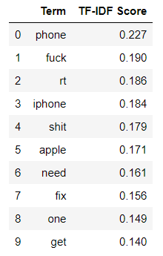
EDA – Apple
Negative

Slide 20
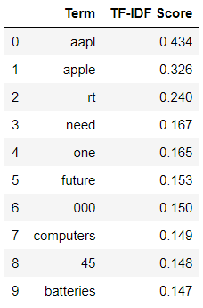
EDA – Apple
Positive

Slide 21
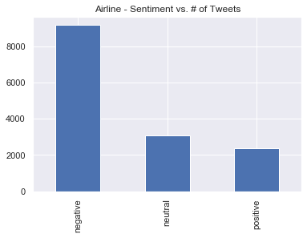
EDA - Airline
Exact Counts:
Neutral: 3,099
Negative: 9,178
Positive: 2,263

Slide 22
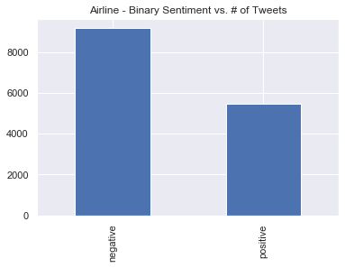
EDA - Airline
Exact Counts:
Negative: 9,178
Positive: 5,462

Slide 23
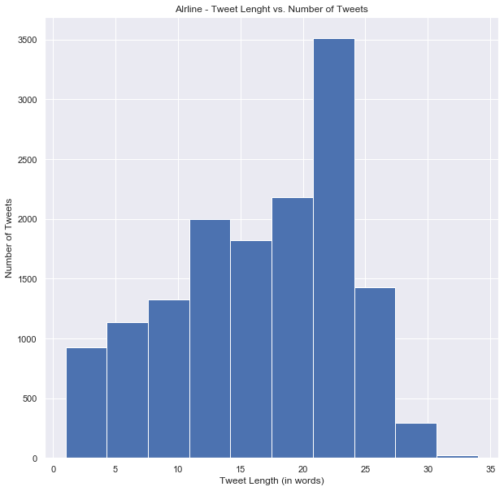

Slide 24
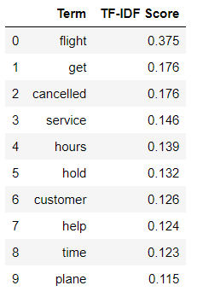
EDA – Airline
Negative

Slide 25
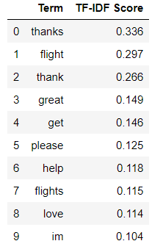
EDA – Apple
Positive

Slide 26
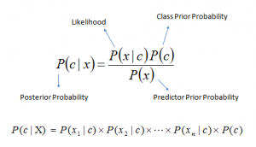
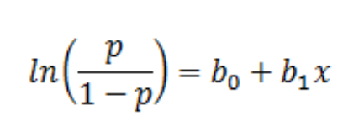
Approach
Model 1: Naïve Bayes
Model 2: Logistic Regression

Slide 27
Approach – 8 Experiments
Result # | Model | Test/Train Data | Validation Data | Result Reported
1 | Naïve Bayes | Apple | Airline | Test
2 | Naïve Bayes | Apple | Airline | Validation
3 | Naïve Bayes | Airline | Apple | Test
4 | Naïve Bayes | Airline | Apple | Validation
5 | Log Regression | Apple | Airline | Test
6 | Log Regression | Apple | Airline | Validation
7 | Log Regression | Airline | Apple | Test
8 | Log Regression | Airline | Apple | Validation

Slide 28
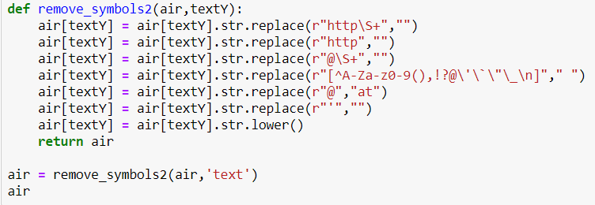
Experimental Setup - Standardization

Slide 29
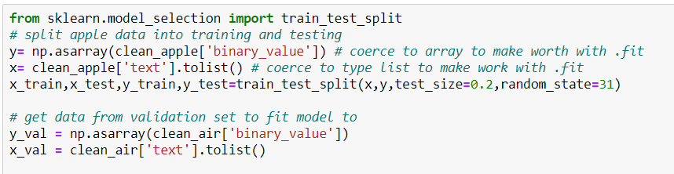
Experimental Setup - Segregation

Slide 30
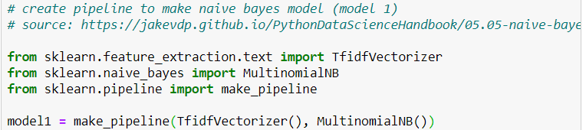
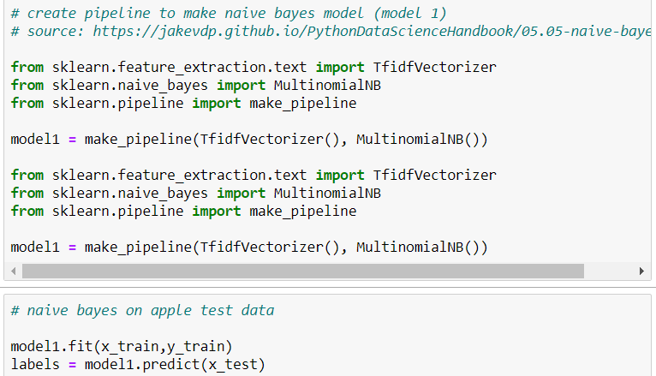
Experimental Setup – Fitting the Models

Slide 31

Experimental Results and Analysis

Slide 32
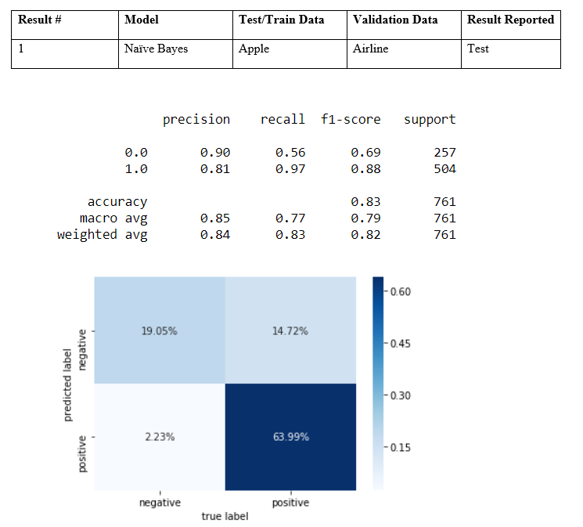

Slide 33
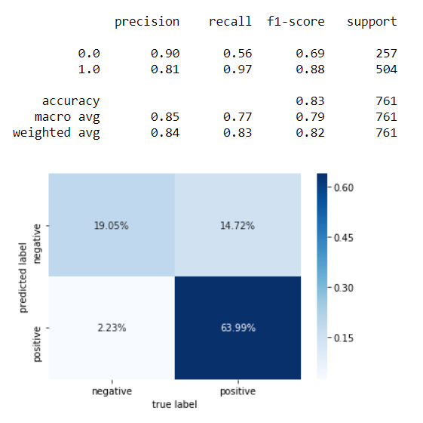
Result # | 1
Model | Naïve Bayes
Test/Train Data | Apple
Validation Data | Airline
Result Reported | Test

Slide 34
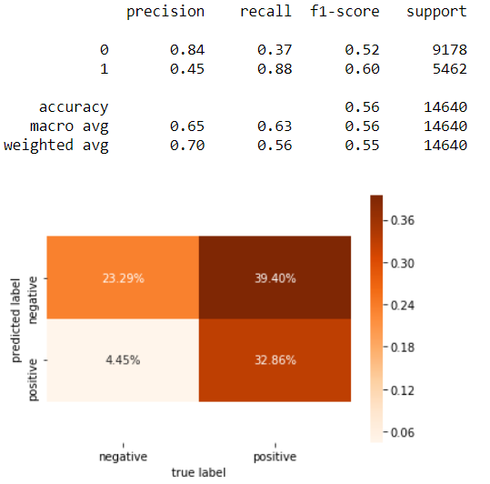
Result # | 2
Model | Naïve Bayes
Test/Train Data | Apple
Validation Data | Airline
Result Reported | Validation

Slide 35
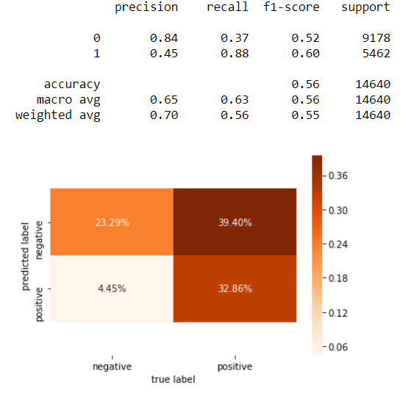
Result # | 3
Model | Naïve Bayes
Test/Train Data | Airline
Validation Data | Apple
Result Reported | Test

Slide 36
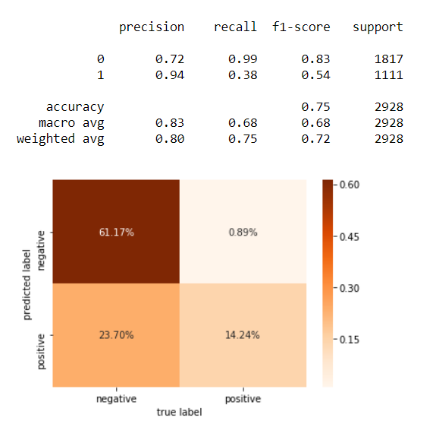
Result # | 3
Model | Naïve Bayes
Test/Train Data | Airline
Validation Data | Apple
Result Reported | Test

Slide 37
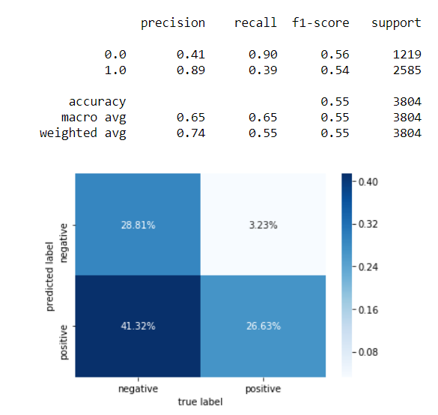
Result # | 4
Model | Naïve Bayes
Test/Train Data | Airline
Validation Data | Apple
Result Reported | Validation

Slide 38
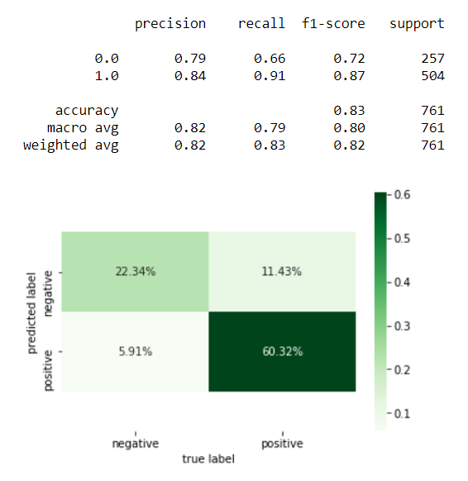
Result # | 5
Model | Log Regression
Test/Train Data | Apple
Validation Data | Airline
Result Reported | Test

Slide 39
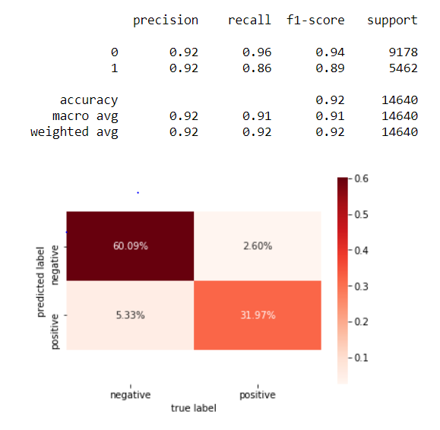
Result # | 6
Model | Log Regression
Test/Train Data | Apple
Validation Data | Airline
Result Reported | Validation

Slide 40
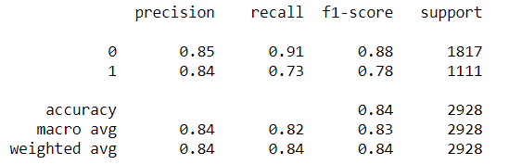
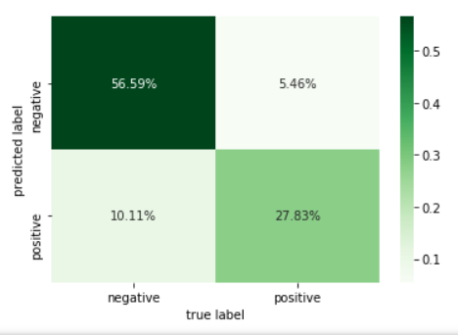
Result # | 7
Model | Log Regression
Test/Train Data | Airline
Validation Data | Apple
Result Reported | Test

Slide 41
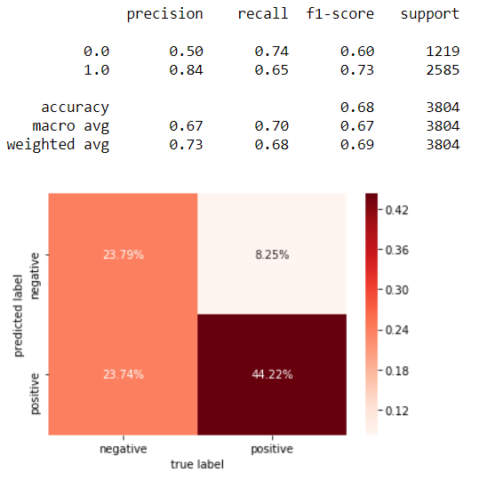
Result # | 8
Model | Log Regression
Test/Train Data | Airline
Validation Data | Apple
Result Reported | Validation

Slide 42
Conclusion
The ability of two models, the naïve bayes classifier and the logistic regression, to accurately predict the overall sentiment of a tweet directed by an organization was tested and compared.
The naïve bayes classifier was shown to severely overfit the data no matter which dataset it was trained on.
Not capable of generating meaningful results outside of its training dataset.

Slide 43
Conclusion
The logistic regression model performed very well on validation data, correctly classifying 92% of tweets, suggesting that it may be well suited to this application.
Drawbacks:
1) Not fully robust to switching the datasets used for training/testing and validation.
2) Tends to underrate negative sentiment, which is bad for cybersecurity applications.
This may cause an organization not to adequately invest in cyberdefense and make it vulnerable to attack.

